Slide 1
Python programming
Willard Williamson
Adjunct Professor
iSchool, Syracuse University
linkedin.com/in/ncc-1701-d

Slide 2
Credits
The slides in this deck draw heavily from professor Daniel Acuna’s IST-718 class slides.

Slide 3
Resources
As a Syracuse University Student, you get a free subscription to the lynda.com learning web site which is part of LinkedIn.
Log in at https://lynda.syr.edu using your SU login credentials.
If you have a LinkedIn account, you should now have access to Lynda training tutorials through LinkedIn Learning.
LinkedIn Learning is available through your LinkedIn home page.
The next few slides show how to access Lynda learning content for free using LinkedIn Learning.

Slide 4
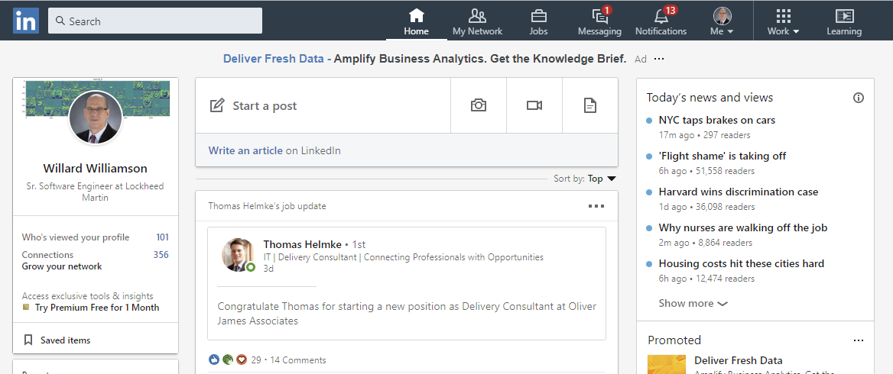
Resources
Log into LinkedIn and select Learning (See the red outline to the right)

Slide 5
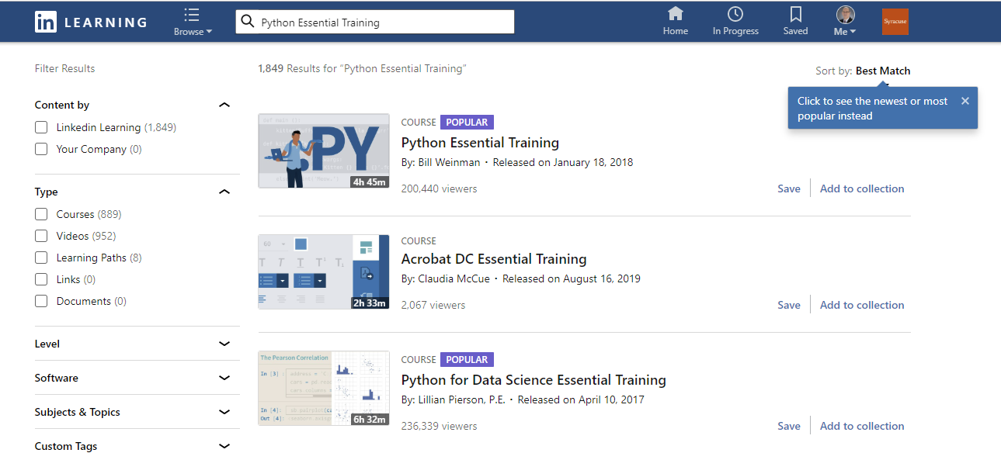
Resources: Lynda Python Essential Training
If you logged into Lynda using your SU account as described on a previous slide, you should see the SU organization logo.
Search for Python Essential Training

Slide 6
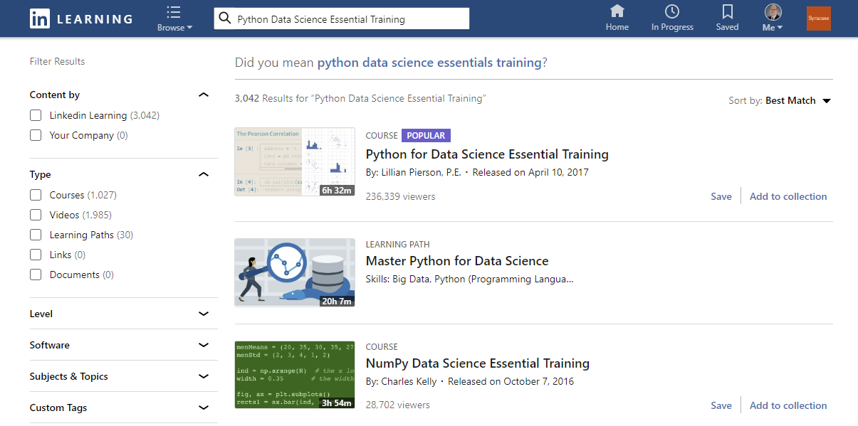
Resources: Lynda Data Science Essentials

Slide 7
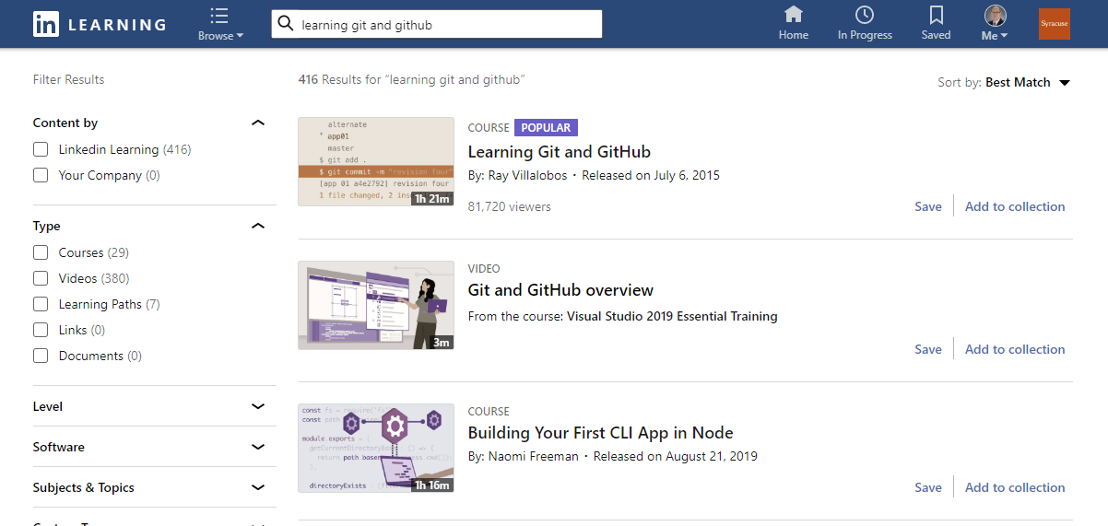
Resources: Github

Slide 8
Other Resources
If you are coming from R: http://mathesaurus.sourceforge.net/matlab-python-xref.pdf
Learn Python the Hard Way (book): https://learnpythonthehardway.org/python3/

Slide 9
Anaconda
Anaconda is a managed python environment
Owned by Anaconda, Inc.
Base install provides a large collection of scientific computing packages
Provides the ability to create customized work environments
Example:
Create a python environment where python == 3.4 including spyder, pandas and numpy.
Create another environment where python == 2.7 including jupyter and scikit-learn.
Biggest advantage of Anaconda environment is that it’s easier to create environments and install python packages than other tools.
https://docs.anaconda.com/anaconda/navigator/tutorials/

Slide 10
Install
If you haven’t yet, install Anaconda Python 3
Download: https://www.anaconda.com/distribution/
Install Instructions: https://docs.continuum.io/anaconda/install/
Check that it is available when you open your terminal by running:
python --version
Should return something like the following:
(ist718) C:\IronKey\SU\IST-718>python --version
Python 3.7.3
Test your installation:
Create the following script with an editor:
print(“Hello, World”)
Save as hello_world.py
Run at the terminal: python hello_world.py

Slide 11
Install Needed Packages
From the terminal window, install useful packages:
conda update -n base -c defaults conda -y
conda install numpy -y
conda install pandas -y
conda install pyspark -y
conda install scikit-learn -y
conda install sympy -y
conda install matplotlib -y
conda install seaborn –y
conda install beautifulsoup4 -y

Slide 12
Update Anaconda Packages
conda update numpy -y
conda update pandas -y
conda update pyspark -y
conda update scikit-learn -y
conda update sympy -y
conda update matplotlib -y
conda update seaborn –y
conda update beautifulsoup4 –y
conda update lxml -y

Slide 13
Interacting with Python: Jupyter Notebook
Jupyter Notebooks are Very popular
Runs in a web browser
Great for presentations because Jupyter supports markdown text
Included by default in Anaconda

Slide 14
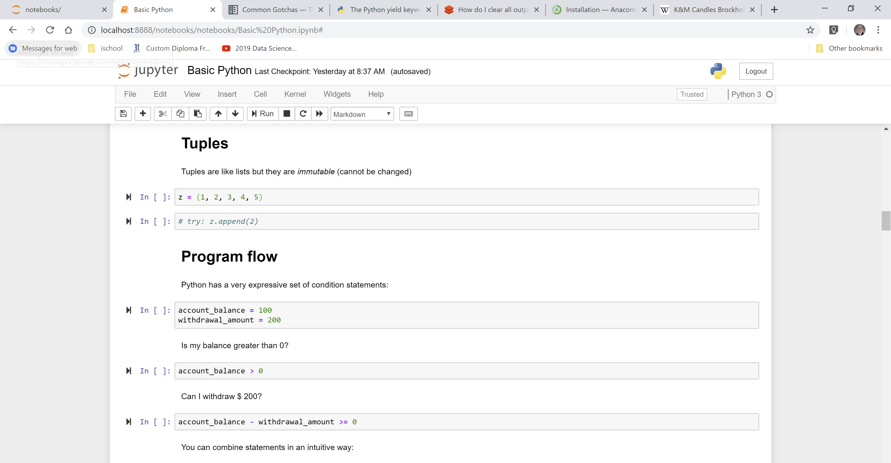
Jupyter Notebook Screen Shot

Slide 15
Using Python with scripts
Create a file with your code
Run it with Python
You can pass parameters to the program
For example, the following program reads paramaters from the terminal and prints them out import sys print(sys.argv)

Slide 16
Demonstration Using iPython
Go to the terminal
Execute the iptyhon command
Try some things:
Declare a variable
Print it
A variable holds a value and that value can be changed later
A variable has a type
You can access the type using the function ‘type’
If you try to use a variable that it is not declared, it will throw a NameError exception
Access help

Slide 17
Spyder Demo: Pandas Dataframes
Load iris_dataframe.py
Inspect the dataframe using the variable explorer

Slide 18
Anaconda Jupyter notebook
Go to the terminal and run: jupyter notebook
Running in the background keeps the terminal free for other tasks
To run in the background on a Mac or Linux: jupyter notebook &
To run in the background on Windows: start jupyter notebook
Create a markdown cell
Create a code cell

Slide 19
Databricks Jupyter Notebook
Log into Databricks
Upload ‘IST-718 Python Tutorial.ipynb’ notebook

Slide 20
Blogs and others
Kaggle’s No Free Hunch blog (Interviews with winners)
http://blog.kaggle.com/
KDnuggets (Knowledge Discovery):
http://www.kdnuggets.com/
Win-Vector blog (R programming language)
http://www.win-vector.com/blog/
Andrew Gelman’s blog
http://andrewgelman.com/
Nate Silver’s blog
https://fivethirtyeight.com/live-blog/

